Slide 1
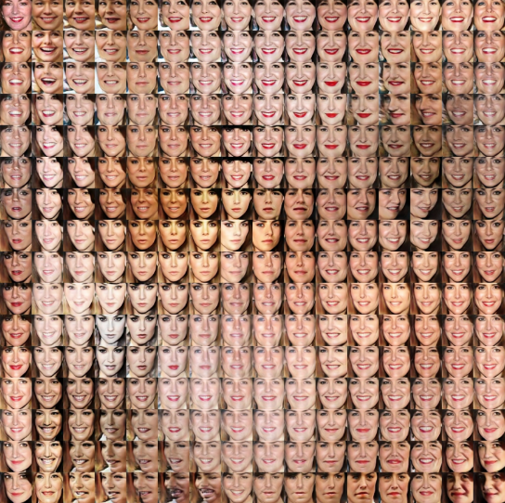
Data Augmentation GAN
Habib Ibrahim
Abd Elaziz Hamed
Antoniou, A., Storkey, A. and Edwards, H., 2017. Data augmentation generative adversarial networks. arXiv preprint arXiv:1711.04340.

Slide 2
Introduction
“Effective training of neural networks requires much data”
Low-data regime can limit the neural network learning in several ways.
Challenges:
neural networks seem to fall short
overfitting on the training set
producing poor generalisation on the test set
Solution: Data Augmentation

Slide 3
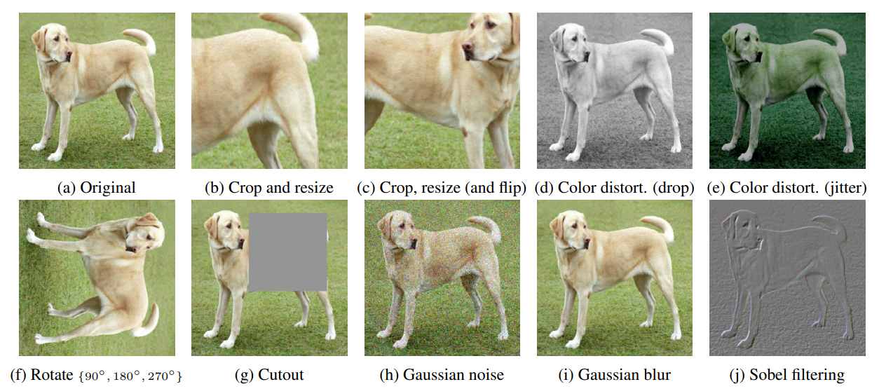
Data Augmentation
Data augmentation is a technique used in machine learning and deep learning to artificially increase the size and diversity of a training dataset by applying various transformations to the existing data samples.
The goal of data augmentation is to improve the generalization and robustness of machine learning models by exposing them to a wider range of variations in the input data.
Data Augmentation Techniques
Geometric Transformations
Color Transformations
Noise Addition
Cutout

Slide 4
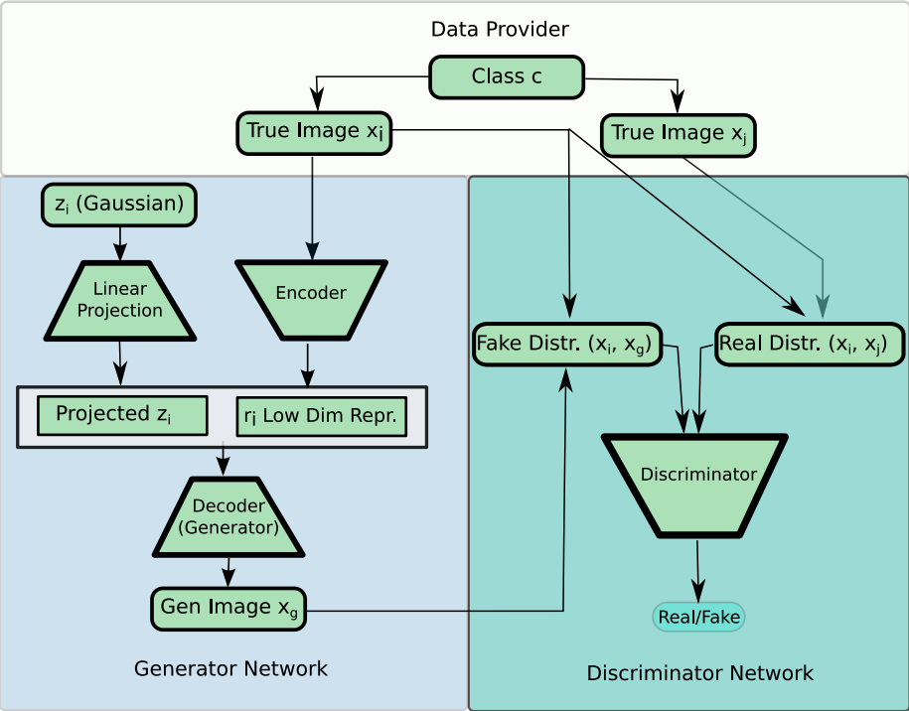
What is DAGAN?
Generator: URESNET
Discriminate: DENSENET
Adversarial training leads the network to generate new images from an old one that appear to be within the same class but look different enough to be a different sample.

Slide 5

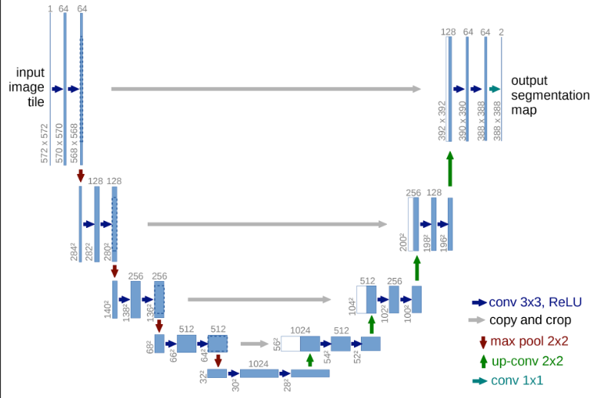
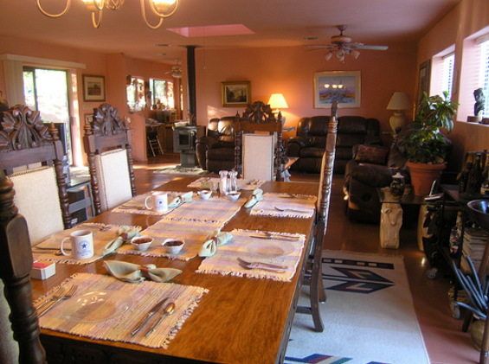
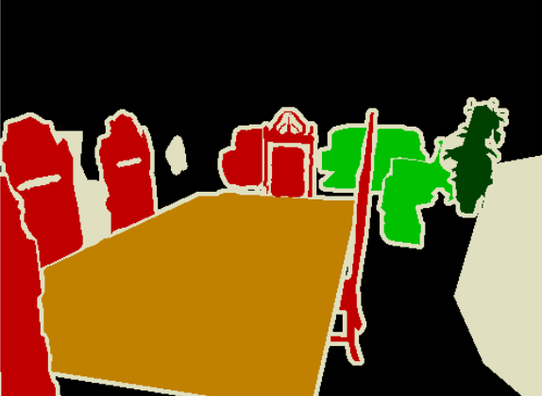
UNet

Slide 6
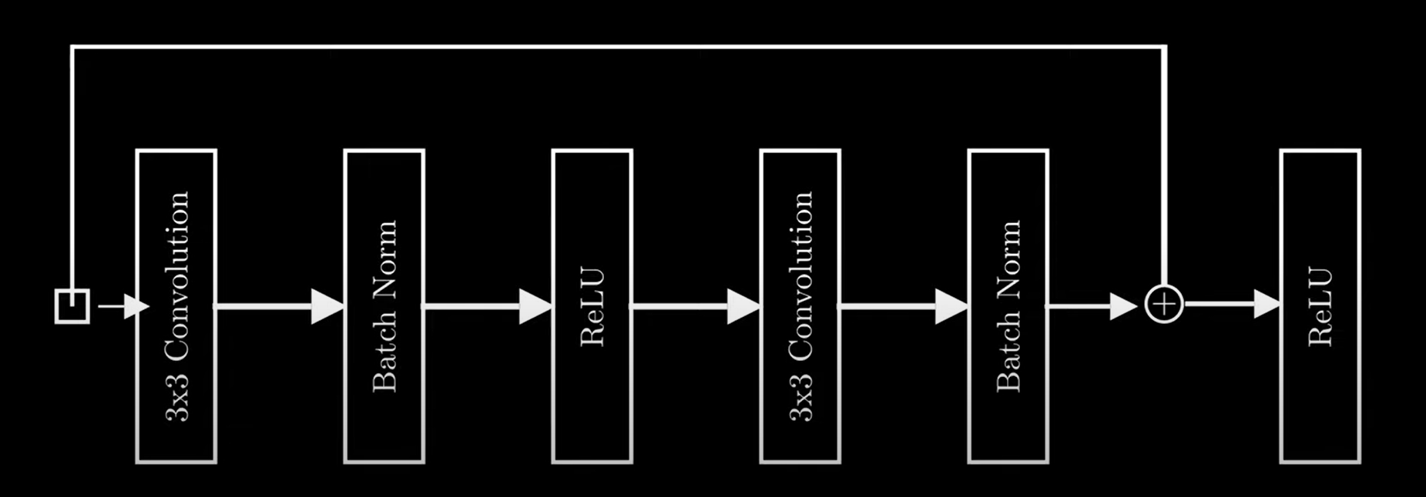
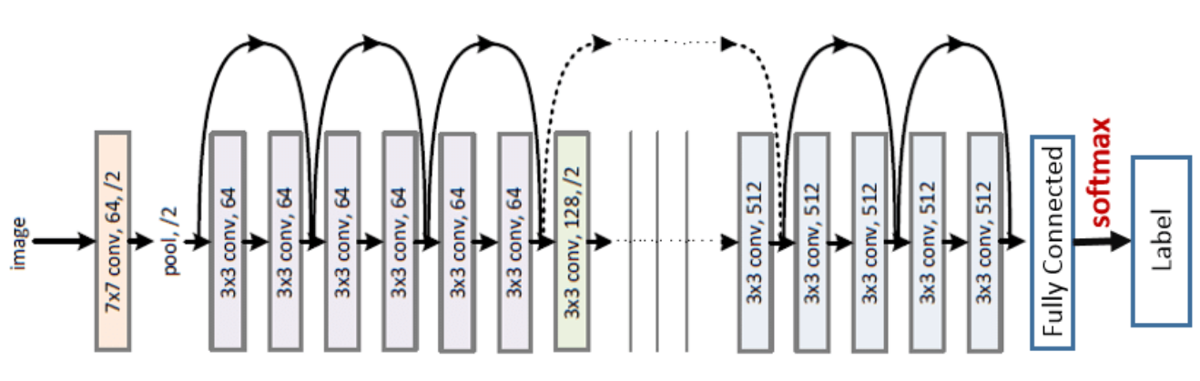
ResNet

Slide 7
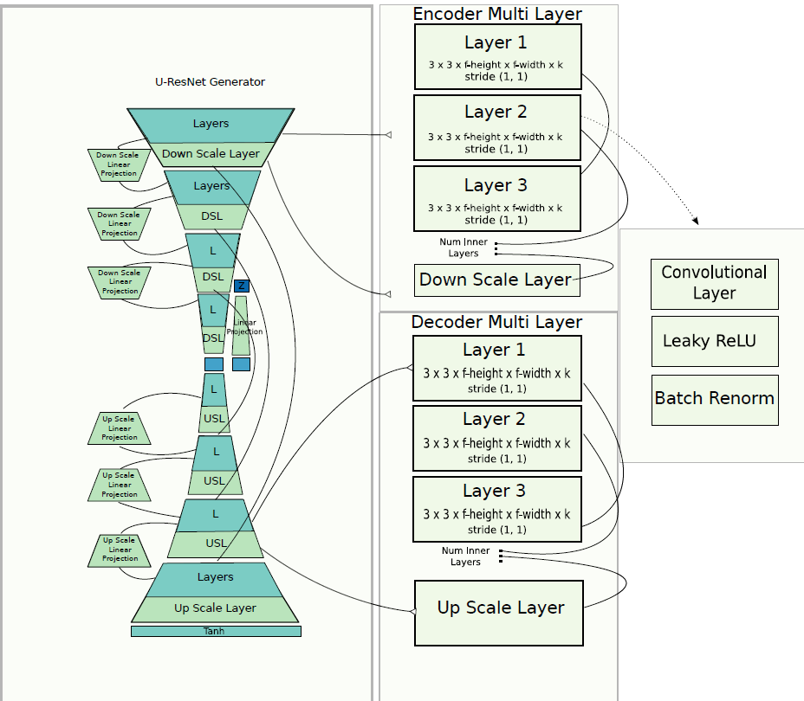
DAGAN Generator
(UResNet)

Slide 8
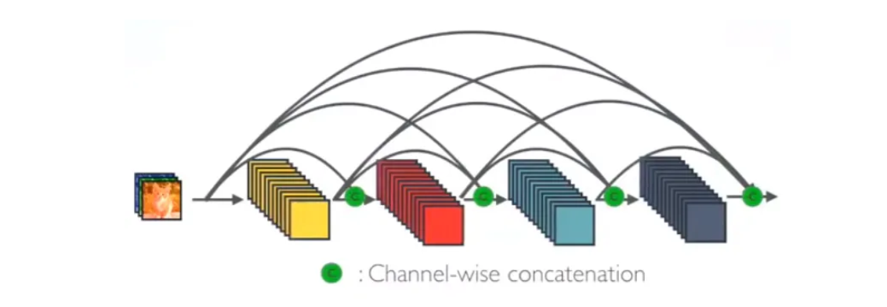

Dense Net

Slide 9
DenseNet Discriminator
Dense block
Dense block
Dense block
Dense block
Transition layer
Transition layer
Transition layer
Transition layer
Dense block
Transition layer
Conv2d
X4
Conv
Dropout
Pooling

Slide 10
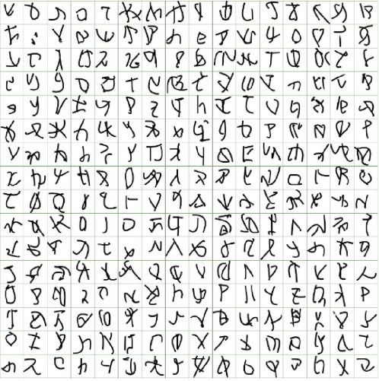
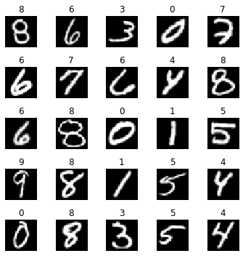
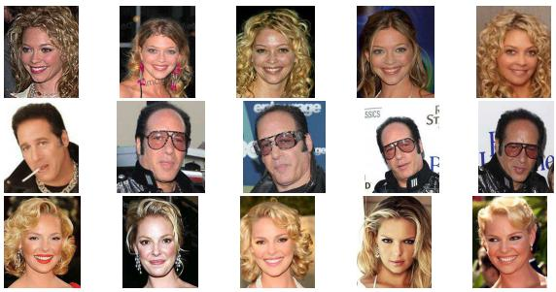
Datasets
Omniglot
EMNIST
VGG-Faces
Each dataset was split randomly into three subsets: source domain sets, validation domain sets, and test domain sets

Slide 11
DAGAN Training And Dataset Usage
Classifier Network
One-Shot Networks
Data within each subset was divided into 2 test cases, 3 validation cases, and a variable number of training cases.
Classifier networks were trained on the training cases from all domains.
Test performance was evaluated only on the test cases from the target domain set.
Case splits were randomized across each test run to ensure robust evaluation.
DAGAN training was performed on the source domain.
Meta-learning was conducted on the same source domain.
Validation was carried out on the validation domain.
Results were reported based on the target domain data

Slide 12
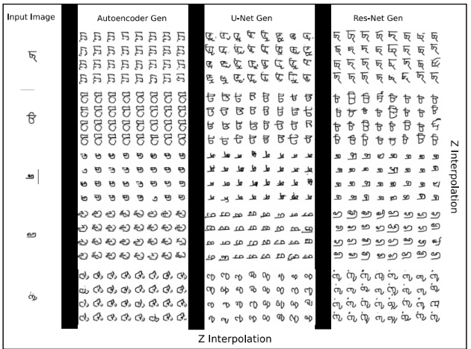
DAGAN Generator Training
DAGAN is trained on the Omniglot dataset, which consists of handwritten characters from alphabets.
DAGAN framework was trained using various architectures: standard VGG, U-nets, and ResNet
Experimentation revealed that more powerful architectures led to better results in generating diverse and high-quality samples.

Slide 13

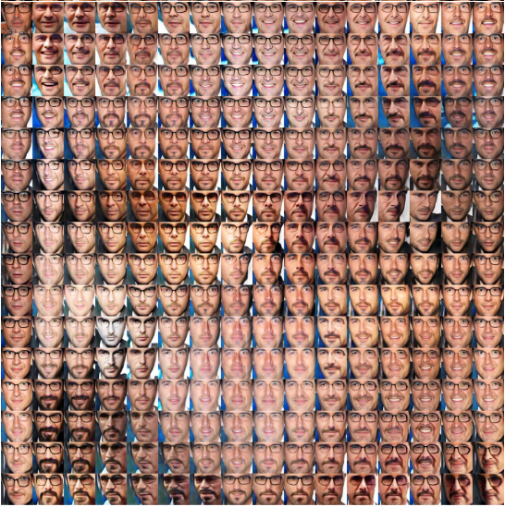
DAGAN Generator Training Performance
Among the various architectures tested, the UResNet architecture, is identified as the model of choice.
This suggests that the combination of features from both U-nets and ResNet architectures provides optimal performance for the generator network.

Slide 14
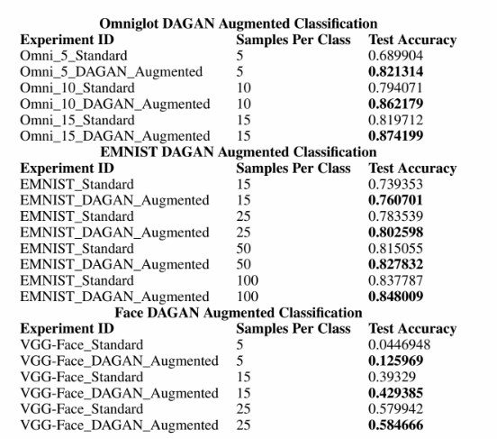
DAGAN Discriminator Training and performance
Baseline Classifier Training:
DenseNet classifier is trained first on just real data from the target domain.
The classifier is trained with a small number of examples per class, 5, 10, or 15 examples.
Augmentation with DAGAN:
The classifier is trained using both real data and data augmented by DAGAN.
The augmented data generated by DAGAN is provided to the classifier alongside the real data during training.

